Slide 1
Design of a Smart Graphics System
Final Year Major Project
Department of Information Technology
Indian Institute of Engineering Science and Technology, Shibpur
P.O. Botanic Garden, Howrah 711103, WB, India

Slide 2
Project by
Mentor : Prof. Sukanta Das
510817021 - Soumabrata Bhattacharya
510817028 - Rajarshi Mondal
510817058 - Priyankar Roy
510817049 - Anupam Sanidhya

Slide 3
Scope of the Project
The modern graphics systems are heavily dependent on a centralized processing unit(GPU) which takes a considerable toll on the performance and provides no intelligent way to draw required images.
In this project we aim to resolve this issue by making our graphics system divide its entire task of processing into several connected processing units each taking up the place of a pixel. Thus every pixel serves to be its own unit that feeds data to the next pixel as required, making it intelligent.

Slide 4
Objective
Design of a graphical system that can draw intelligently by itself without the need of providing all pixel data.
The system is provided with the start and end points and the display draws rest of the pixels by itself.

Slide 5
Proposed Methodology
The circuit has currently implemented for a modified version of Bresenham’s line drawing algorithm.
Instead of depending on one or more centralized processing units, the pixels decide to which neighbouring pixel the control should be transferred
The input provided is used to calculate some pre-computed data, to be done by the CPU and then use them as heuristic.
This puts significantly lower strain on the CPU and makes the process faster as it is implemented on a hardware level.

Slide 6
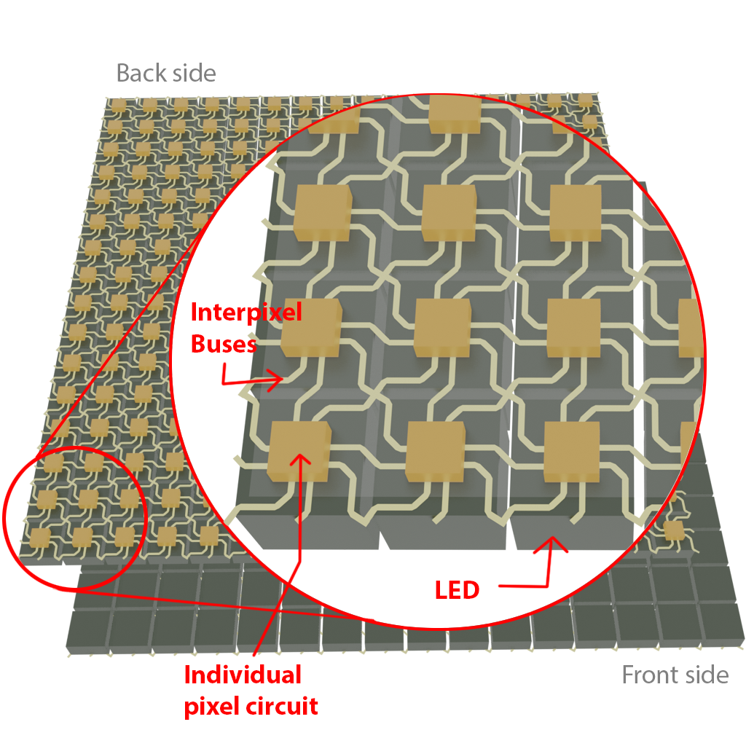
Overview of the
Graphics System

Slide 7
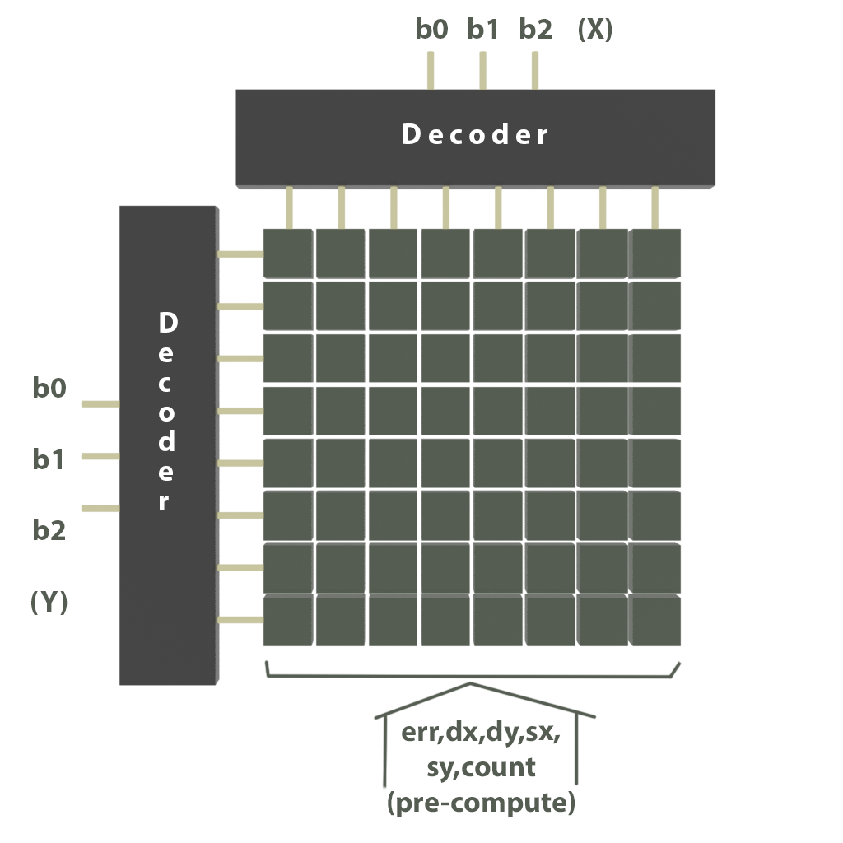
Sending Precomputes

Slide 8
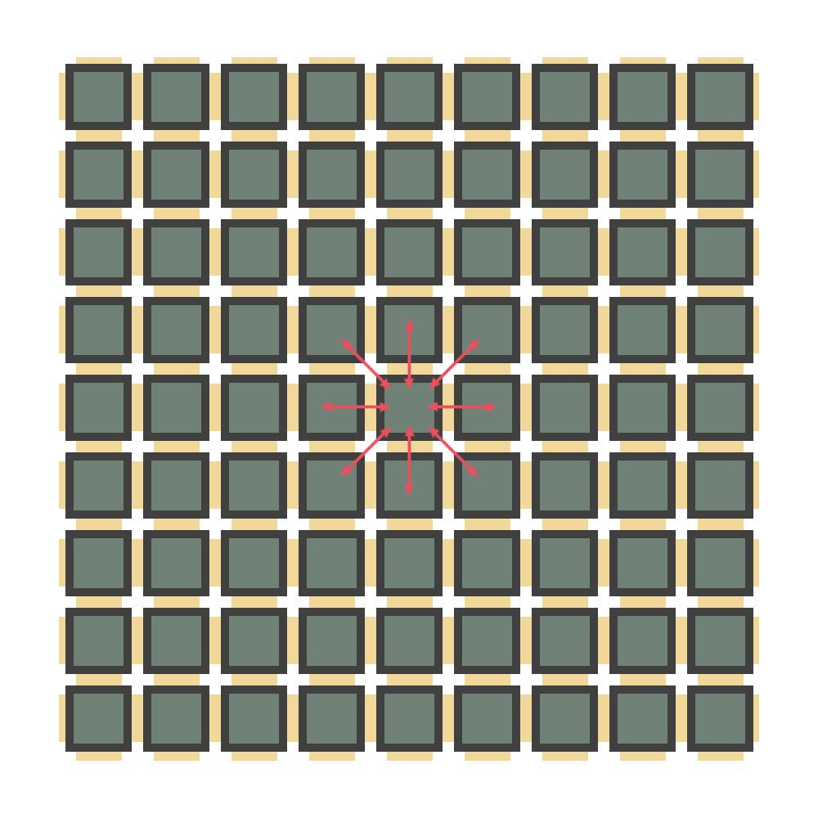
Pins
sx : 0 if x0<x1 else 1
sy : 0 if y0<y1 else 1
C : Counter
dx : difference in x axis (always positive)
dy : difference in y axis (always positive)
err : Error offset (dx-dy)
M_{in} : Toggle representing incoming
message from which neighbour
M_{out}: Toggle representing outgoing message to which neighbour
Vcc : Power
GND : Ground

Slide 9
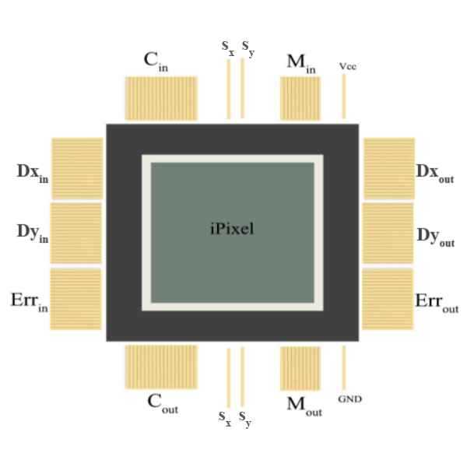
Structure of a Pixel

Slide 10
Input
The circuit contains two 8 x 256 decoders for which each of the 256 outputs address a row and a column. After the input has been provided, its binary will be fed to the grid which will set the input pixel as high, depending on the outputs of the two decoders.

Slide 11
Precomputes
(i) dx : Difference in x-axis (always positive)
(ii) dy: Difference in y - axis(always positive)
(iii) sx : 0 if x0<x1 else 1
(iv) sy : 0 if y0<y1 else 1
(v) err: dx-dy.

Slide 12
Algorithm
while(true){
path.push([y0,x0,err])
state.grid.grid[y0][x0].err = err
if (x0===x1 && y0===y1){
break;
}
let e2 = 2*err
if(e2 > -dy){
err = err-dy
x0 = x0+sx
}
if(e2 < dx){
err = err + dx
y0 = y0 + sy
}
}

Slide 13
x0, y0 : Coordinates of starting pixels.
x1, y1 : Coordinate of the ending pixel.
state : Matrix representing the 256 x 256 grid of pixels.
err : Error value that gets calculated for every pixel

Slide 14
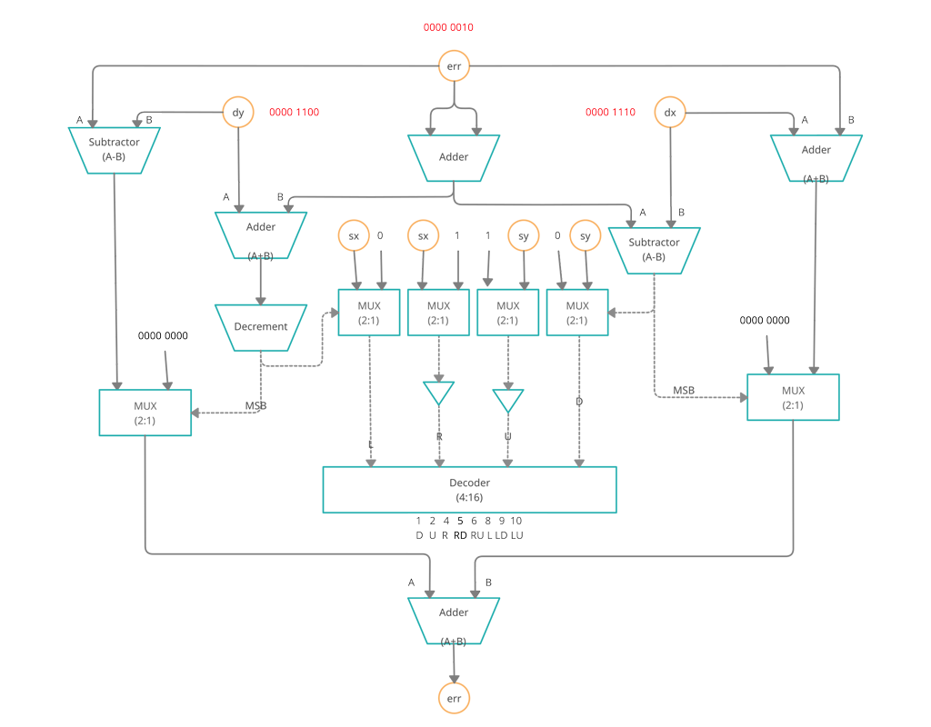
Working of a single pixel

Slide 15
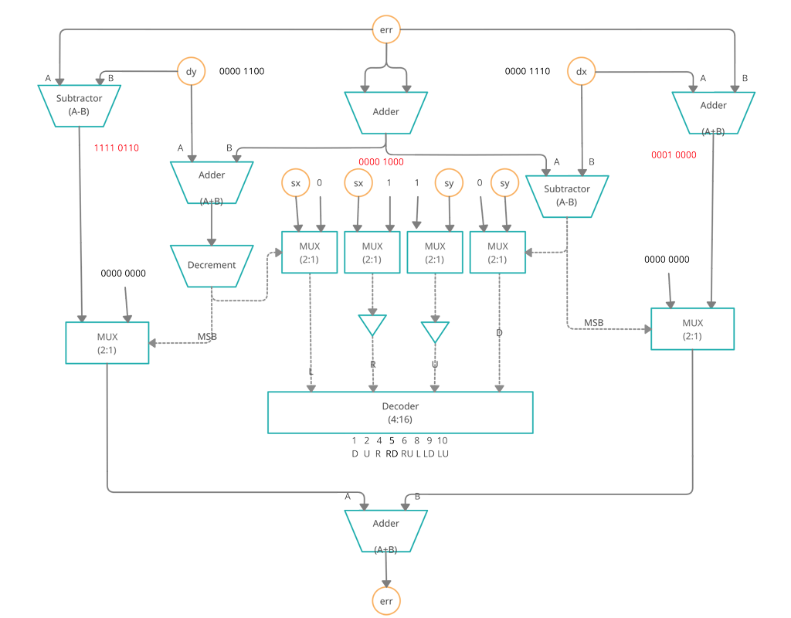

Slide 16
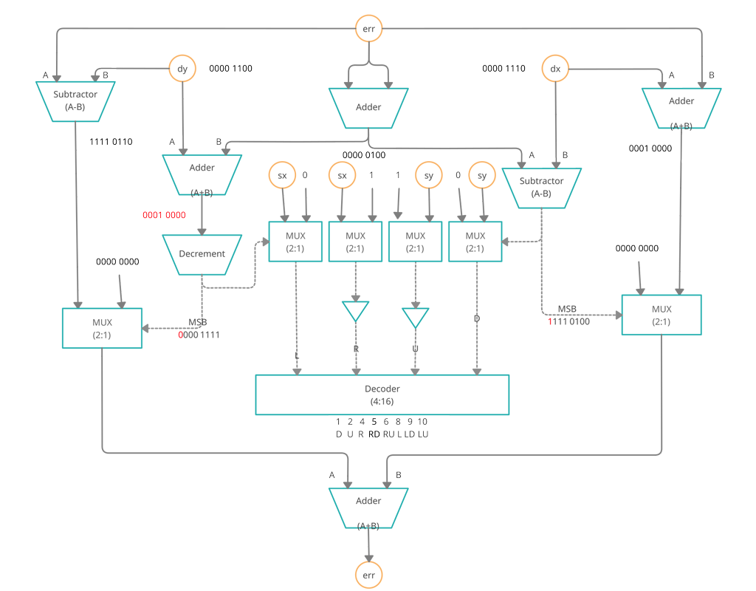

Slide 17
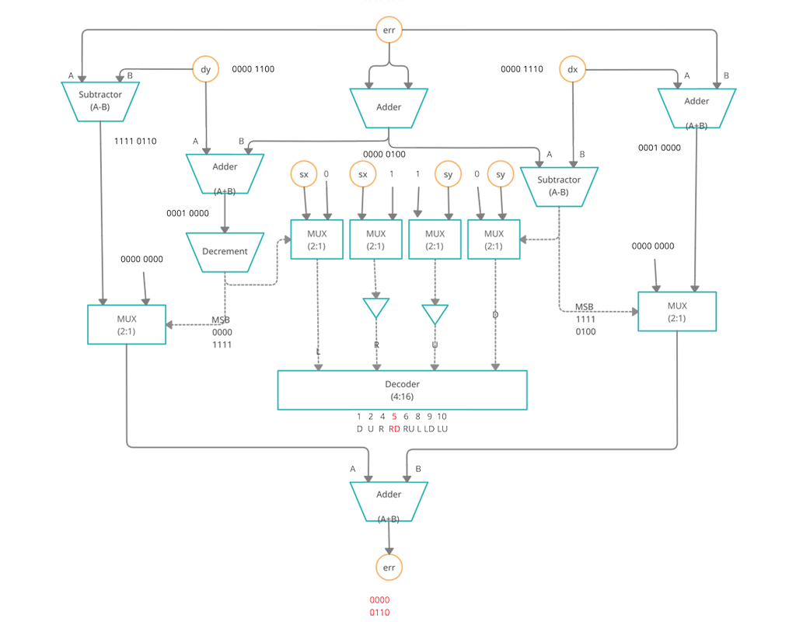

Slide 18
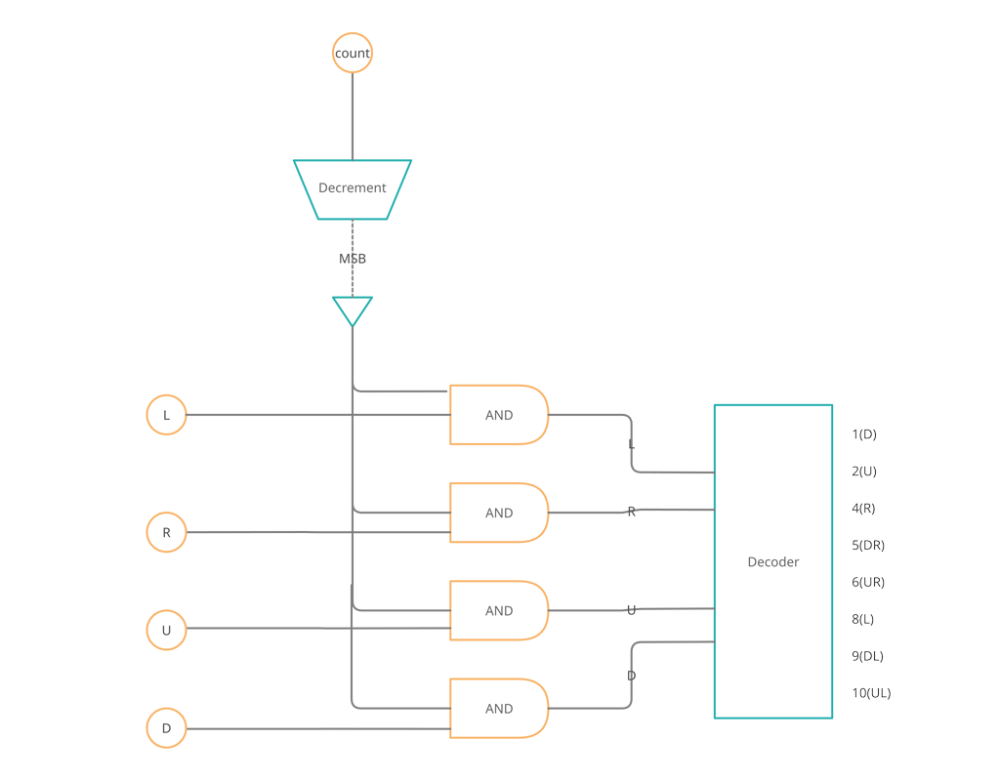

Slide 19
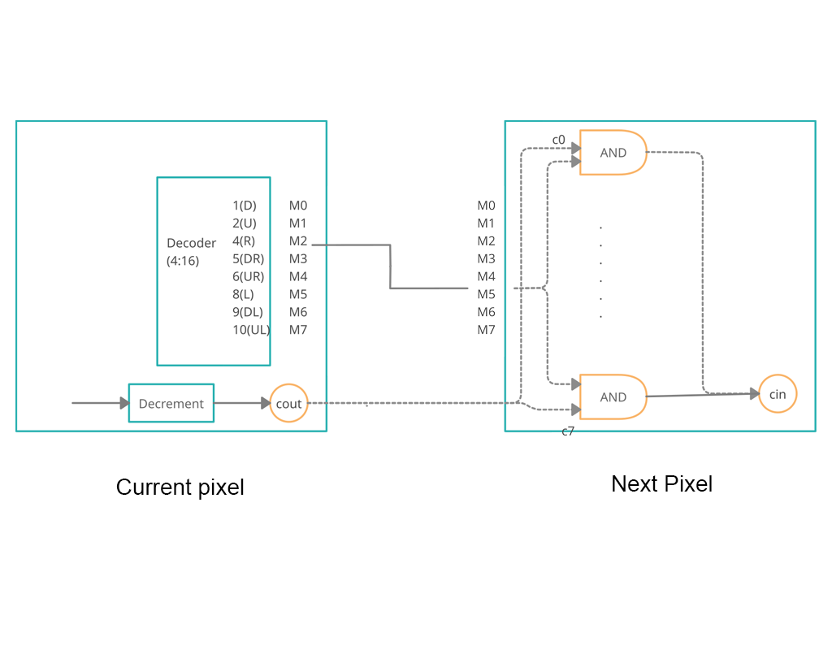
Transfer of control from one pixel to next

Slide 20
Size Estimate for a 256 x 256 screen
A big concern of our project is its scalability. The circuit has to fit within a size of a pixel.
Average Area of a Pixel 6.76 x 10^4 nm².
Size of a small transistor is 100 nm² , so there can be 2704 transistors per pixel.
Number of two input transistors in an AND Gate is 2
Number of transistors needed to make a 2x1 Multiplexer is 10.
Number of transistors needed to make an 8-bit Full Adder is 96.
Number of transistors needed to make a 4 x 16 Decoder is 40.
Total number of transistors needed for our circuit is 840.

Slide 21
Transistor number calculation for a 256 x 256 screen pixel
Number of Multiplexers in one pixel = 6
Number of Adders in one pixel = 7
Number of Decoder in one pixel = 1
Number of 2 input and gates for input needed = number of bits in precomputes x 2
= 34 x 2 = 68.
Total number of transistors needed = 46x 10 + 7 x 96 + 40 + 68
= 840

Slide 22
Theoretical Minimum Pixel size
Resolution | Avg. number of transistors per pixel | Minimum pixel size
256 x 256 | 840 | 287 nm
512 x 512 | 932 | 302 nm
1024 x 1024 | 1044 | 320 nm
2048 x 2048 | 1172 | 335 nm

Slide 23
Challenges
Collision of 2 messages.
Deletion of a specific line, in case of overlapping lines
Current hardware design has been implemented only for line drawing and need to be expanded for curve drawing
Accommodating space between pixel and circuit for avoidance of noise interference may compromise with the predicted resolution

Slide 24
References
[1] Algorithm for a computer control of a digital plotter, IBM Systems Journal
[2] New Efficient Design for XOR Function on the Transistor Level by Tripti Sharma, K.G.Sharma, B.P.Singh and Neha Arora
[3] Transistor Gates (gsu.edu)
[4] Pixel - Wikipedia

